Slide 1
数 据 库 原 理
Chp 7
Relational Database Design
王 建 民
清 华 大 学 软 件 学 院
2023年/春

Slide 2
本节课的内容
理论 | 核心知识点 | 对应章节
数据库理论 | 关系模型、关系代数、关系演算 | CHP. 1、2
数据库应用 | SQL语言、JDBC | CHP3、4、5
数据库设计 | 实体-联系图、关系范式 | CHP6、7
数据库实现 | 存贮、索引、查询、优化、 事务、并发、恢复 | CHP12、13、14、15、 16、17、18、19

Slide 3
本章回答的主要问题
已知数据库属性集合以及属性之间取值的约束，判断一个关系模式是否是“好”的？
“好”的标准是关系中没有数据冗余，同时能方便地操作这些数据；如果不好，如何通过拆分得到“好”的关系模式。

Slide 4
Database System Design Phases
活动/阶段
文档/制品
Requirements Collection & Analysis Requirement
需求工程
User Story
Requirement
Specification
Conceptual Design
概念设计
Conceptual
Model
E-R Model
Logical Design
逻辑设计
Relational
Model
Logical
Model
Physical Design
物理设计
Final
Schema
Application Design
应用开发
Application
Programs
Output
Phase

Slide 5
大学数据库的用户故事
The university is organized into departments. Each department is identified by a unique name (dept name), is located in a particular building, and has a budget.
Each department has a list of courses it offers. Each course has associated with it a course id, title, dept name, and credits, and may also have associated prerequisites.
Instructors are identified by their unique ID. Each instructor has name, associated department (dept name), and salary.
Students are identified by their unique ID. Each student has a name, an associated major department (dept name), and tot cred (total credit hours the student earned thus far)

Slide 6
大学数据库的用户故事(c1)
The university maintains a list of classrooms, specifying the name of the building, room number, and room capacity.
The university maintains a list of all classes (sections) taught. Each section is identified by a course id, sec id, year, and semester, and has associated with it a semester, year, building, room number, and time slot id (the time slot when the class meets).
The department has a list of teaching assignments specifying, for each instructor, the sections the instructor is teaching.
The university has a list of all student course registrations, specifying, for each student, the courses and the associated sections that the student has taken (registered for).

Slide 7

大学数据库的ER图
Entity-Relationship Diagram
Entity-Relationship Data Model

Slide 8

大学数据库的关系模型图
1
2
10
3
4
5
11
7
6
8
Notes:
Takes(ID, course_id, sec_id, semester, year, grade)
Student(ID, name, dept_name, tot_cred)
Course(course_id, title, dept_name, credits)
Department(dept_name, building, budget)
Advisor(s_id, i_id)
Instructor(ID, name, dept_name, salary)
Prereq(course_id, prereq_id)
Teaches(ID, course_id, sec_id, semester, year)
Classroom(building, room_no, capacity)
Section(course_id, sec_id, semester, year, building, room_no, time_slot_id)
Time_slot(time_slot_id, day, start_time, end_time)

Slide 9
大学数据库的关系表
takes(ID, course_id, sec_id, semester, year, grade)
student(ID, name, dept_name, tot_cred)
course(course_id, title, dept_name, credits)
department(dept_name, building, budget)
advisor(s_id, i_id)
instructor(ID, name, dept_name, salary)
prereq(course_id, prereq_id)
teaches(ID, course_id, sec_id, semester, year)
classroom(building, room_no, capacity)
section(course_id, sec_id, semester, year, building, room_no, time_slot_id)
time_slot(time_slot_id, day, start_time, end_time)
Notes:
Takes(ID, course_id, sec_id, semester, year, grade)
Student(ID, name, dept_name, tot_cred)
Course(course_id, title, dept_name, credits)
Department(dept_name, building, budget)
Advisor(s_id, i_id)
Prereq(course_id, prereq_id)
Teaches(ID, course_id, sec_id, semester, year)
Classroom(building, room_no, capacity)
Section(course_id, sec_id, semester, year, building, room_no, time_slot_id)
Time_slot(time_slot_id, day, start_time, end_time)

Slide 10
Relational-database Design
To generate a set of relation schemas to store information without unnecessary redundancy and to retrieve information easily
Normal form(范式) is a criteria(准则) for us to judge whether the relation schemas are “good” enough?
范式就是判断一个关系模式“好”“坏”程度的准则

Slide 11
Main Contents
First Normal Form
Pitfalls in Relational Database Design
Functional Dependencies
Decomposition
BCNF and 3NF
Database-Design Process

Slide 12
第一范式：First Normal Form
Domain is atomic(原子的) if its elements are considered to be indivisible units
A relational schema R is in first normal form(第一范式) if the domains of all attributes of R are atomic

Slide 13
原子性
Atomicity is actually a property of how the elements of the domain are used
Strings would normally be considered indivisible
  CS0012 or EE1127
    Student identification numbers
  If the first two characters are extracted to find the department, the domain of identification numbers is not atomic
  Doing so is a bad idea
    leads to encoding of information in application program rather than in the database

Slide 14

违反原子性的例子
Non-atomic values may lead storage redundancy and complexity.
Customers
Zhang,M,19
Zhang,M,19
Wang，F，22
……
……
……
……
We assume all relations are in first normal form in our course

Slide 15
Main Contents
First Normal Form
Pitfalls in Relational Database Design
Functional Dependencies
Decomposition
BCNF and 3NF
Database-Design Process

Slide 16
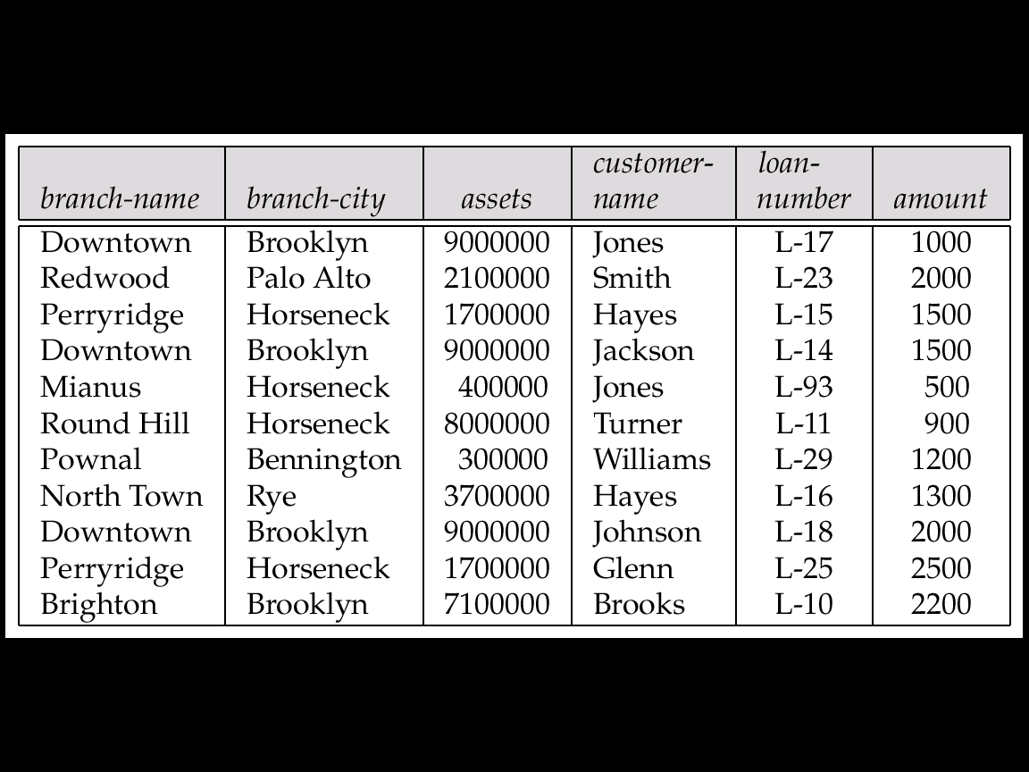
关系模式的“坑”
Consider the relation schema
Lending-schema = (branch-name, branch-city, assets, customer-name, loan-number, amount)

Slide 17
带来的问题是什么？
Redundancy
  Data for branch-name, branch-city, assets are repeated for each loan that a branch makes
    wastes space
    Complicates updating
Cannot store information about a branch if no loans exist
  Can use null values, but they are difficult to handle
    Select count(loan-number) from lending-schema;
    or Select count(*) from lending-schema;
信息冗余
修改异常
插入异常
删除异常

Slide 18
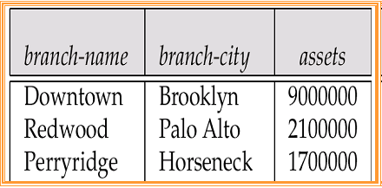
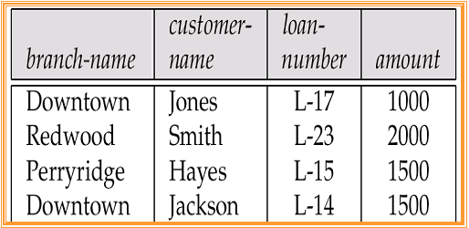
如何解决？关系模式分解
Decompose the relation schema Lending-schema into
    Branch-schema = (branch-name, branch-city,assets)
    Loan-info-schema = (customer-name, loan-number,
    branch-name, amount)
?
Notes:
We need more space to store the relation
What the benefit we obtain?

Slide 19
关系模式设计的目标
Avoid redundant data
避免信息冗余
Avoid anomalies of insert, delete and update
避免插入异常、删除异常和修改异常
Facilitate the checking of modifications for violation of database integrity constraints
Notes:
便于

Slide 20
关系模型设计理论
Whether a particular relation R is in “good” form?
How can we decompose a relation R in “bad” form into a set of relations {R₁, R₂, ..., R_{n}} such that each relation is in “good” form?
Our theory is based on
  Functional Dependencies(函数依赖)
  Multivalued Dependencies(多值依赖)

Slide 21
Main Contents
First Normal Form
Pitfalls in Relational Database Design
Functional Dependencies
Decomposition
BCNF and 3NF
Database-Design Process

Slide 22
函数依赖的定义
Let R be a relation schema, α ⊆ R and β ⊆ R
The functional dependency α → β
holds on(保持) R if and only if for any legal relations r(R), whenever any two tuples t₁ and t₂ of r agree on the attributes α, they also agree on the attributes β. That is, t₁[α] = t₂ [α] ⇒ t₁[β ] = t₂ [β ]
α
β
t₁
t₁[α]
t₁[β ]
t₂
t2[α]
t₂[β ]

Slide 23
函数依赖的例子
A relation instance, r
K is a superkey for relation schema R if and only if K → R
K is a candidate key for R if and only if
  K → R, and for no α ⊂ K, α → R
A B
4
1 5
3 7
On this instance, A → B does NOT hold, but B → A does hold

Slide 24
函数依赖的性质
函数依赖是关系的一致性约束
    Require that the value for a certain set of attributes determines uniquely(唯一确定) the value for another set of attributes
关系实例中一个属性集取值确定以后，另一个属性集取值也确定了
    A functional dependency is a generalization of the notion of a key

Slide 25
用函数依赖表达一致性约束
Functional dependencies allow us to express constraints that cannot be expressed using superkeys
Consider the schema
  Loan-info-schema = (customer-name, loan-number,
  branch-name, amount)
We expect this set of functional dependencies to hold:
loan-number → amount
loan-number → branch-name
but would not expect the following to hold:
loan-number → customer-name

Slide 26
A Geometric View of FD’s
An Instance Space of R(A,B)，A，B为自然数
{(1,2), (3,4)}
{}
{(5,1)}
{(1,2), (3,4), (1,3)}
Notes:
Imagine the set of all instances of a particular relation is a relation instance space
Each instance is a point in this space

Slide 27
满足函数依赖约束的子集
For FD A -> B there is a subset of all instances that satisfy the FD
We can represent an FD by a region in the space
A -> B
{(1,2), (3,4)}
{}
{(5,1)}
{(1,2), (3,4), (1,3)}

Slide 28
函数依赖的应用场景
We use functional dependencies to
  Test relations to see if they are legal under a given set of functional dependencies
    If a relation r is legal under a set F of functional dependencies, we say that r satisfies F
  Specify constraints on the set of legal relations
    We say that F holds on R if all legal relations on R satisfy the set of functional dependencies F

Slide 29
满足(Satisfied)与保持(Hold On)
A specific instance of a relation schema may satisfy a functional dependency even if the functional dependency does not hold on all legal instances
For example, a specific instance of Loan-Info-schema may, by chance, satisfy
loan-number → customer-name

Slide 30
平凡的函数依赖
A functional dependency is trivial(平凡的) if it is satisfied by all instances of a relation schema
  E.g.
    customer-name, loan-number → customer-name
    customer-name → customer-name
In general, α → β is trivial if β ⊆ α

Slide 31
函数依赖集合的闭包F⁺
Given a set of functional dependencies, there are certain other functional dependencies that are logically implied(蕴含) by F
  If A → B and B → C, then we can infer that A → C
The set of all functional dependencies logically implied by F is the closure(闭包) of F， F⁺

Slide 32
Armstrong公理
We can find all of F⁺ by applying Armstrong’s Axioms)
  Reflexivity(自反律)
  if β ⊆ α, then α → β
  augmentation (增广律)
  if α → β, then γ α → γ β
  transitivity (传递律)
  if α → β, and β → γ, then α → γ
Notes:
These rules are
sound (有效性）generate only functional dependencies that actually hold on R
complete (完备性）generate all functional dependencies that hold on R

Slide 33
已知关系R和函数依赖F求F⁺
R = (A, B, C, G, H, I)
F = { A → B
A → C
CG → H
CG → I
B → H }
some members of F⁺
  A → H
  AG → I
  CG → HI

Slide 34
人工计算F⁺
We can further simplify manual computation of F⁺ by using the following additional rules
  If α → β holds and α → γ holds, then α → β γ holds (union)合并规则
  If α → β γ holds, then α → β holds and α → γ holds (decomposition)分解规则
  If α → β holds and γ β → δ holds, then α γ → δ holds (pseudotransitivity)伪传递规则
The above rules can be inferred from Armstrong’s axioms

Slide 35
属性集合的闭包
Given a set of attributes α, define the closure（闭包） of α under F (denoted by α⁺) as the set of attributes that are functionally determined by α under F:
α → β is in F⁺ ⬄ β ⊆ α⁺
Notes:
Alpha 关于函数依赖集F的闭包
函数依赖集F闭包中任意一个左端为alpha的函数依赖，其右端的属性集合Beta都是Alpha关于函数依赖集F的闭包的子集
Alpha关于函数依赖集F的闭包的任意子集作为右端，Alpha作为左端的函数依赖一定在函数依赖集F的闭包中

Slide 36
属性集合闭包α⁺的算法
Algorithm to compute α⁺, the closure of α under F
result := α;
while (changes to result) do
for each β → γ in F do
begin
if β ⊆ result then result := result ∪ γ
end
β
γ
result
new result

Slide 37
计算属性集合闭包的例子
R = (A, B, C, G, H, I)
F = {A → B
A → C
CG → H
CG → I
B → H}
(AG)⁺ = ?
B
H
AG
C
I
{A B C G H I}

Slide 38
属性闭包的三个用处
Testing for superkey
  To test if α is a superkey, we compute α^{+,} and check if α⁺ contains all attributes of R
Testing functional dependencies
  To check if a functional dependency α → β holds (or, in other words, is in F⁺), just check if β ⊆ α⁺
  That is, we compute α⁺ by using attribute closure, and then check if it contains β
  Is a simple and cheap test, and very useful

Slide 39
属性闭包的三个用处(c1)
Computing closure of F
  For each γ ⊆ R, we find the closure γ⁺, and for each S ⊆ γ⁺, we output a functional dependency γ → S
Notes:
Complexity

Slide 40
函数依赖集合中的冗余
Sets of functional dependencies may have redundant dependencies that can be inferred from the others
  Eg:A → C is redundant in: {A → B, B → C, A → C}
Parts of a functional dependency may be redundant
  E.g. on RHS: {A → B, B → C, A → CD} can be simplified to {A → B, B → C, A → D}
  E.g. on LHS: {A → B, B → C, AC → D} can be simplified to {A → B, B → C, A → D}

Slide 41
额外的（多余的）属性
Consider a set F of functional dependencies and the functional dependency α → β in F
  Attribute A is extraneous(额外的) in α if A ∈ α
  and F logically implies (F – {α → β}) ∪ {(α – A) → β}
  Attribute A is extraneous(额外的) in β if A ∈ β
  and the set of functional dependencies
  (F – {α → β}) ∪ {α →(β – A)} logically implies F
stronger functional dependency always implies a weaker one
Notes:
额外的\多余的，F是基准，既不能扩大也不能缩小。
A α → α ?

Slide 42
冗余属性的例子
Example1
Given F = {A → C, AB → C }
  B is extraneous in AB → C
  because A → C logically implies AB → C
Example2
Given F = {A → C, AB → CD}
  C is extraneous in AB → CD
  since AB → CD can be inferred from {A → C, AB → D}

Slide 43
如何测试属性是冗余的
Consider a set F of functional dependencies and the functional dependency α → β in F
Left-hand Side（左边）
  To test if attribute A ∈ α is extraneous in α
    compute (α– {A })⁺ using the dependencies in F
    check that (α – {A})⁺ contains β; if it does, A is extraneous
  Right-hand Side （右边）
  To test if attribute A ∈ β is extraneous in β
    compute α⁺ using only the dependencies in
    F’ = (F – {α → β}) ∪ {α →(β – A)},
    check that α⁺ contains A; if it does, A is extraneous

Slide 44
规范/标准覆盖
Intuitively, a canonical cover of F is a “minimal” set of functional dependencies equivalent to F, without redundant functional dependencies and redundant parts of functional dependencies
Notation is F_{c}

Slide 45
规范/标准覆盖的性质
A canonical cover for F is a set of dependencies F_{c} such that
  F logically implies all dependencies in F_{c,} and
  F_{c} logically implies all dependencies in F, and
  No functional dependency in F_{c} contains an extraneous attribute, and
  Each left side of functional dependency in F_{c} is unique(合并)

Slide 46
标准覆盖的计算过程
R = (A, B, C)
F = {A → BC, B → C, A → B, AB → C}
Combine A → BC and A → B into A → BC
  Set is now {A → BC, B → C, AB → C}
A is extraneous in AB → C,
because B → C logically implies AB → C
  Set is now {A → BC, B → C}

Slide 47
标准覆盖的计算过程(c1)
Now dependency set is {A → BC, B → C}
C is extraneous in A → BC,
since A → BC is logically implied by A → B and B → C
The canonical cover F_{c} is:
{A → B, B → C}
Notes:
A->B, B->C; AA->AB, AB->BC; A->AB, AB->BC; A->BC;

Slide 48
Main Contents
First Normal Form
Pitfalls in Relational Database Design
Functional Dependencies
Decomposition
BCNF and 3NF
Database-Design Process

Slide 49
关系分解
In the case that a relation R is not in “good” form, decompose it into a set of relations {R₁, R₂, ..., R_{n}}
such that
  each relation is in good form
  the decomposition is a lossless-join(无损连接) decomposition
  Dependency preservation

Slide 50
分解的例子
Decompose
Lending-schema = (branch-name, branch-city, assets, customer-name, loan-number, amount)
into:
Branch-schema = (branch-name, branch-city,assets)
Loan-info-schema = (customer-name, loan-number,
branch-name, amount)
All attributes of an original schema (R) must appear in the decomposition (R₁, R₂), or
R = R₁ ∪ R₂

Slide 51
连接无损(Lossless-join)的分解
For all possible relations r of schema R
r = ∏_{R1} (r) ∏_{R2} (r)
A decomposition of R into R₁ and R₂ is lossless join if and only if at least one of the following dependencies is in F⁺:
  R₁ ∩ R₂ → R₁
  R₁ ∩ R₂ → R₂

Slide 52
连接有损 (Lossy-Join)的分解
Decomposes R = (A, B) into R₁ = (A) R₂ = (B)
A
B
A
B
α
α
β
1
2
1
α
β
1
2
∏_{A}(r)
∏_{B(r)}
r
∏_{A} (r) ∏_{B} (r)
A
B
α
α
β
β
1
2
1
2
Lossy-join decompositions result in information loss

Slide 53
保持依赖 (Dependency preservation )
  Let F_{i} be the set of dependencies F⁺ that include only attributes in R_{i}（F⁺ 在 R_{i}上的投影）
  Preferably the decomposition should be dependency preserving, that is, (F₁ ∪ F₂ ∪ … ∪ F_{n})⁺ = F⁺
  Otherwise, checking updates for violation of functional dependencies may require computing joins, which is expensive

Slide 54
基于函数依赖进行模式分解的原则
Lossless-join decomposition（强制性要求）
  Otherwise decomposition would result in information loss
No redundancy
  The relations R_{i} preferably should be in either Boyce-Codd Normal Form or Third Normal Form
Dependency preservation
  checking updates for violation of functional dependencies do not require computing joins which are expensive

Slide 55
Main Contents
First Normal Form
Pitfalls in Relational Database Design
Functional Dependencies
Decomposition
BCNF and 3NF
Database-Design Process

Slide 56
Boyce-Codd Normal Form
A relation schema R is in BCNF with respect to a set F of functional dependencies
if for all functional dependencies in F⁺ of the form α → β, where α ⊆ R and β ⊆ R,
at least one of the following holds:
α → β is trivial (i.e., β ⊆ α)
α is a superkey for R
BCNF排除了任何属性对码的传递依赖和部分依赖。

Slide 57
Example
R = (A, B, C)
F = {A → B,
B → C}
Key = {A}
R is not in BCNF
Decomposition R₁ = (A, B), R₂ = (B, C)
  R₁ and R₂ in BCNF
  Lossless-join decomposition
  Dependency preserving
Student | Dept | Dean

Slide 58
Testing R for BCNF
To check if a non-trivial dependency α →β in F⁺ causes a violation of BCNF
  1. compute α⁺ (the attribute closure of α)
  2. verify that it includes all attributes of R, that is, it is a superkey of R
R = (A, B, C)
F = {A → B, B → C}
F⁺= {A →A, A → B, A→ C, B → C, … …}

Slide 59
Simplified Testing for BCNF
To check if a relation schema R with a given set of functional dependencies F is in BCNF, it suffices to check only the dependencies in the given set F for violation of BCNF, rather than checking all dependencies in F⁺
  We can show that if none of the dependencies in F causes a violation of BCNF, then none of the dependencies in F⁺ will cause a violation of BCNF either

Slide 60
BCNF 分解算法
result := {R}; done := false;
compute F⁺;
while (not done) do
if (there is a schema R_{i} in result that is not in BCNF)
then begin
let α → β be a nontrivial functional dependency that holds on R_{i} such that α → R_{i} is not in F⁺, and α ∩ β = ∅;
result := (result – R_{i}) ∪ (R_{i} – β) ∪ (α, β );
end
else done := true;
R_{i}
R_{i}-α- β
α
β

Slide 61
BCNF分解举例
R = (branch-name, branch-city, assets,
customer-name, loan-number, amount)
F = {branch-name → assets branch-city
loan-number → amount branch-name}
Key = {loan-number, customer-name}
Decomposition
  R₁ = (branch-name, branch-city, assets)
  R2 = (branch-name, customer-name, loan-number, amount)
  R₃ = (branch-name, loan-number, amount)
  R₄ = (customer-name, loan-number)

Slide 62
BCNF与数据依赖保持
It is not always possible to get a BCNF decomposition that is dependency preserving, ’overnormalized’
R = (J, K, L)
F = {JK → L, L → K}
Two candidate keys = JK and JL
R is not in BCNF
Any decomposition of R will fail to preserve JK → L
Notes:
Let schema(R2) = {STREET, CITY, POSTCODE};
1. S stands for STREET,
2. C stands for CITY, and
3. P stands for POSTCODE.

Slide 63
3NF的初心
There are some situations where
  BCNF is not dependency preserving, and
  Efficient checking for FD violation on updates is important
Solution
  define a weaker normal form, called Third Normal Form(3NF)

Slide 64
3NF的定义
A relation schema R is in third normal form if for all α → β in F⁺
at least one of the following holds:
  α → β is trivial (i.e., β ∈ α)
  α is a superkey for R
  Each attribute A in β – α is contained in a candidate key for R
    Can the candidate key be replaced by superkey?
    Should each attribute be in the same candidate key?
Notes:
A super key(超码) of an entity set is a set of one or more attributes whose values uniquely determine each entity
A candidate key(候选码) of an entity set is a minimal super key

Slide 65
3NF 分解算法
Let F_{c} be a canonical cover for F;
i := 0;
for each functional dependency α → β in F_{c} do
if none of the schemas R_{j}, 1 ≤ j ≤ i contains α β
then begin
i := i + 1;
R_{i} := α β
end
if none of the schemas R_{j}, 1 ≤ j ≤ i contains a candidate key for R
then begin
i := i + 1;
R_{i} := any candidate key for R;
end
return (R₁, R₂, ..., R_{i})

Slide 66
3NF 和 BCNF
If a relation is in BCNF it is in 3NF (since in BCNF one of the first two conditions above must hold)
Third condition is a minimal relaxation of BCNF to ensure dependency preservation

Slide 67
3NF的例子
R = (J, K, L)
Two candidate keys, JK and JL
  R is in 3NF
  JK → L JK is a superkey
  L → K K is contained in a candidate key(J K)
BCNF decomposition
R1= (J, L) and R2= (L, K)
F = {JK → L, L → K}
  Testing for JK → L requires a join

Slide 68
BCNF和3NF
It is always possible to decompose a relation into relations in 3NF and
  the decomposition is lossless, and
  the dependencies are preserved
It is always possible to decompose a relation into relations in BCNF and
  the decomposition is lossless, howerver
  it may not be possible to preserve dependencies

Slide 69
3NF示例
Example of problems due to redundancy in 3NF
R = (J, K, L)
F = {JK → L, L → K}
J
K
L
j₁
j₂
j₃
j4
k₁
k₁
k₁
k₁
l₁
l₁
l₂
l₂
J = street, K = city, and L = zip

Slide 70
3NF
A schema that is in 3NF but not in BCNF has the problems of
  repetition of information
  e.g., the relationship l1, k1
  need to use null values
  e.g., to represent the relationship l2, k2 where there is no corresponding value for J

Slide 71
第二范式
A relation schema R is in second normal form (2NF) if each attribute A in R meets one of the following criteria:
  A appears in a candidate key
  A is not partially dependent on a candidate key
2NF消除了非主属性对码的部分依赖。
Notes:
A super key(超码) of an entity set is a set of one or more attributes whose values uniquely determine each entity
A candidate key(候选码) of an entity set is a minimal super key

Slide 72
Tradeoff in Design
Goal for a relational database design is:
  BCNF
  Lossless join
  Dependency preservation
If we cannot achieve this, we accept one of
  Lack of dependency preservation
  Redundancy due to use of 3NF

Slide 73
Main Contents
First Normal Form
Pitfalls in Relational Database Design
Functional Dependencies
Decomposition
BCNF and 3NF
Database-Design Process

Slide 74
关系范式理论应用场景
R could have been generated when converting E-R diagram to a set of tables.
R could have been a single relation containing all attributes that are of interest (called universal relation).Normalization breaks R into smaller relations.
R could have been the result of some ad hoc design of relations, which we then test/convert to normal form.

Slide 75
场景1 – 我们画的E-R图有缺欠
When an E-R diagram is carefully designed, identifying all entities correctly, the tables generated from the E-R diagram should not need further normalization.
However, in a real (imperfect) design, there can be functional dependencies from non-key attributes of an entity to other attributes of the entity
Example: an employee entity with
  attributes
  department_name and building,
  functional dependency
  department_name→ building
  Good design would have made department an entity

Slide 76
数据模式的反范式化
May want to use non-normalized schema for performance. For example, displaying prereqs along with course_id and title requires join of course with prereq
M. 1: Use denormalized relation containing attributes of course as well as prereq with all above attributes
  faster lookup
  extra space and extra execution time for updates
  extra coding work for programmer and possibility of error in extra code
M. 2: Define a materialized view course_prereq
  Benefits and drawbacks same as above, except no extra coding work for programmer and avoids possible errors

Slide 77
Thank you

